Slide 1

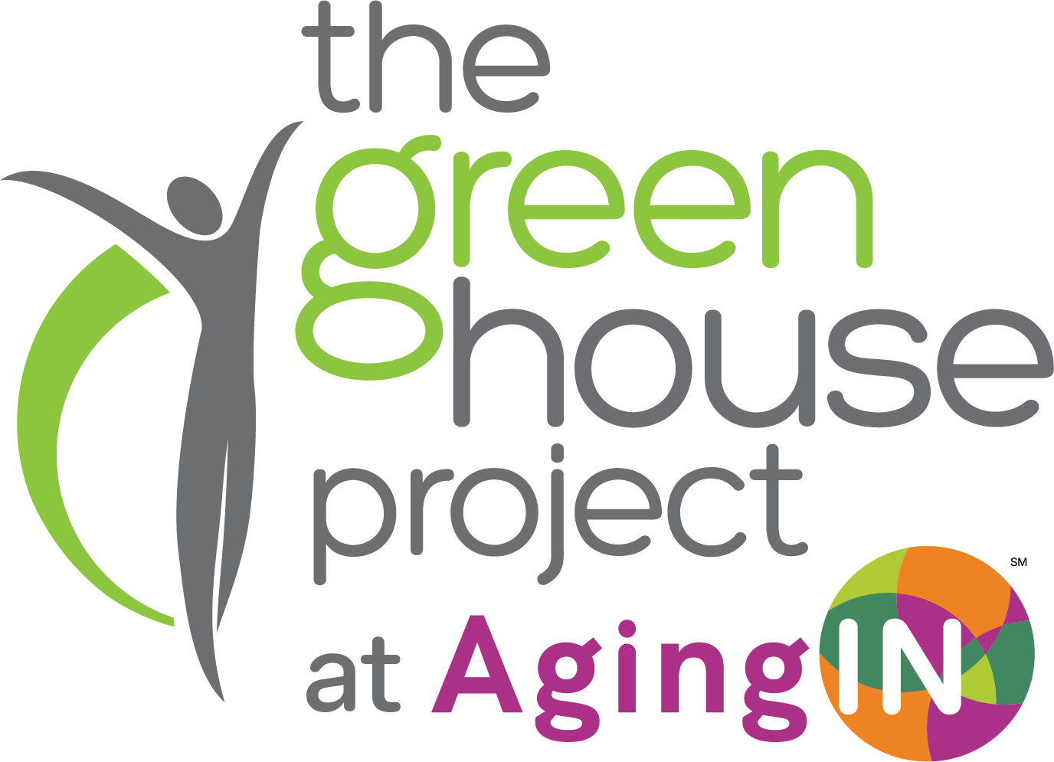
Green House Marketing & PR Toolkit

Slide 2

If We Don’t Tell Our Story, Someone Else Will.
Our Stories Are Stronger When We Tell Them Together.
The Green House Tool Kit is being provided to all Green House homes to…
Give your community marketing and public relations team tools for communicating in your local areas.
To provide a unified voice for the importance and the differentiating factors of operating communities with person-directed living ethos.
To help you attract new residents, customers and employees.
Distinguish the Green House model apart from other care environments.

Slide 3
What’s in the kit?
Sample Press Release: Use this as a base and send to your area newspapers and publications.
Job Bank PDF: AgingIN is creating a job bank and once it’s populated with job listings, we will promote the bank. It’s FREE.
Email: Provides communities with content to email to promote your AgingIN Green House home status.
Newsletter Template
Photography Package for Reference: Referrals to images that will enhance your photo library with what it's like to LIVE in a Green House home. What you won’t see: Medical images with scrubs.
AgingIN Website Content for A Green House Page: This provides pre-written content to make a landing page on your website.
Half and Quarter page AgingIN Advertisement template: Consider running newspaper advertisements to promote your status as a certified Green House home.
Window Cling Art for Front Door of Green House Homes: Yes we operate residential settings but for the outer front door of your building, differentiating as a qualified Green House home makes a difference.
More will be created based on feedback and need

Slide 4
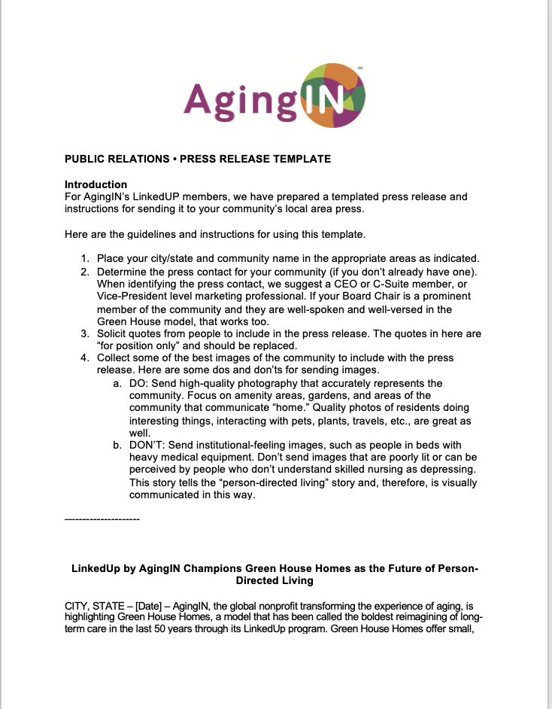
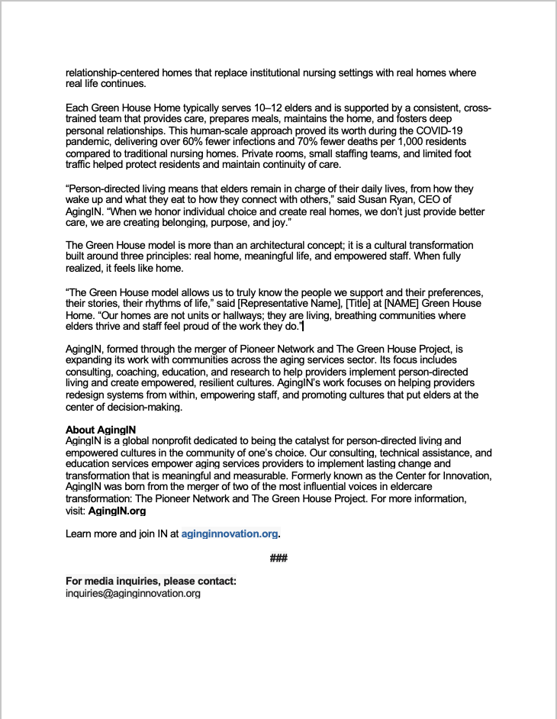
Sample Press Release Template

Slide 5
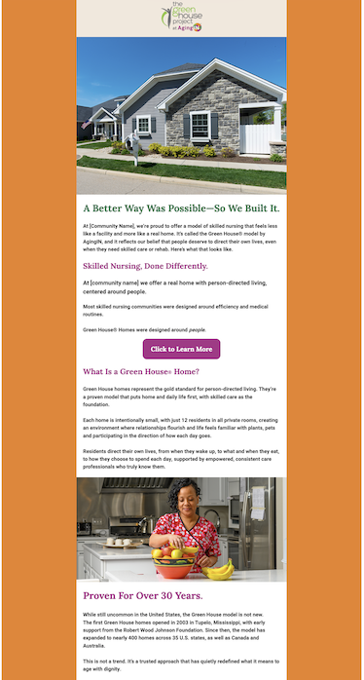
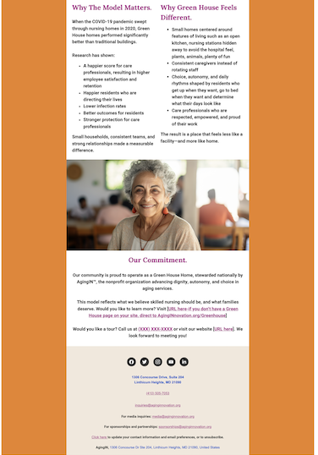
Email Template

Slide 6
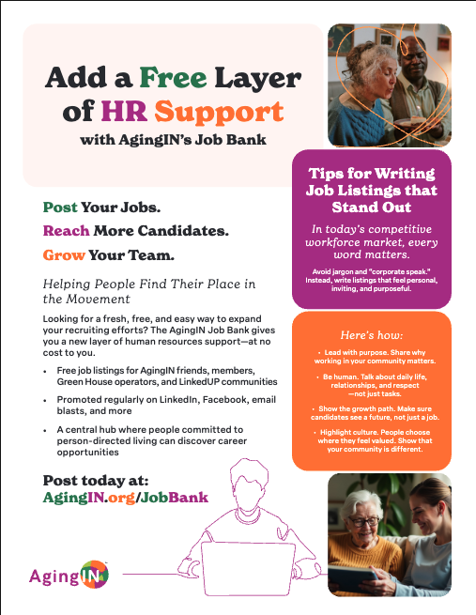
Job Bank
Promoted Across Our Network.
Every month, AgingIN will promote select job openings via:
Our extensive email list of more than 23,000 readers
Newsletter features
Mentions at conferences and events
Direct outreach to our community of change-driven professionals
We want your opportunity to get the visibility it deserves—among the people who truly care about transforming aging.

Slide 7
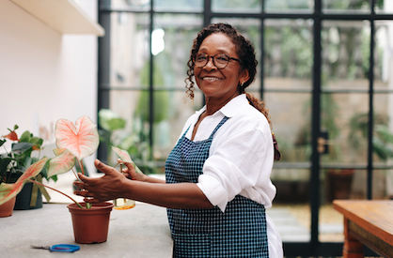
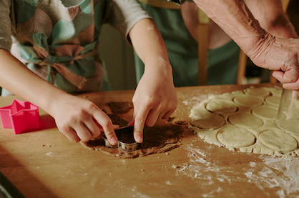
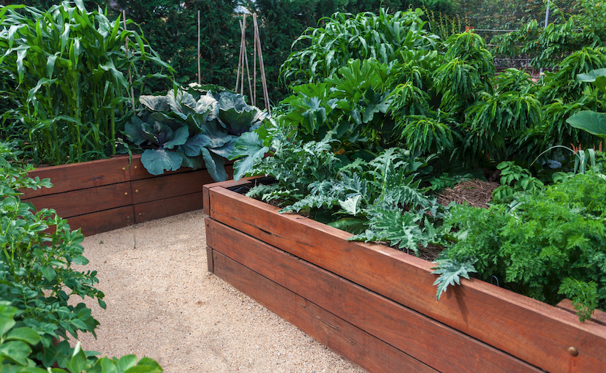
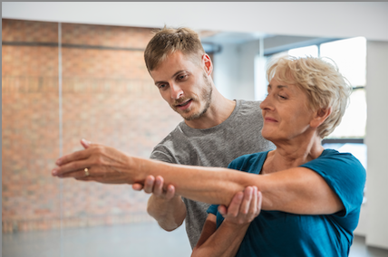

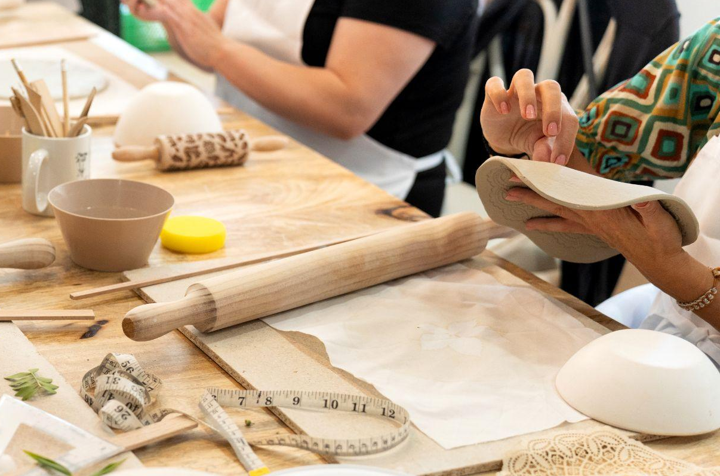
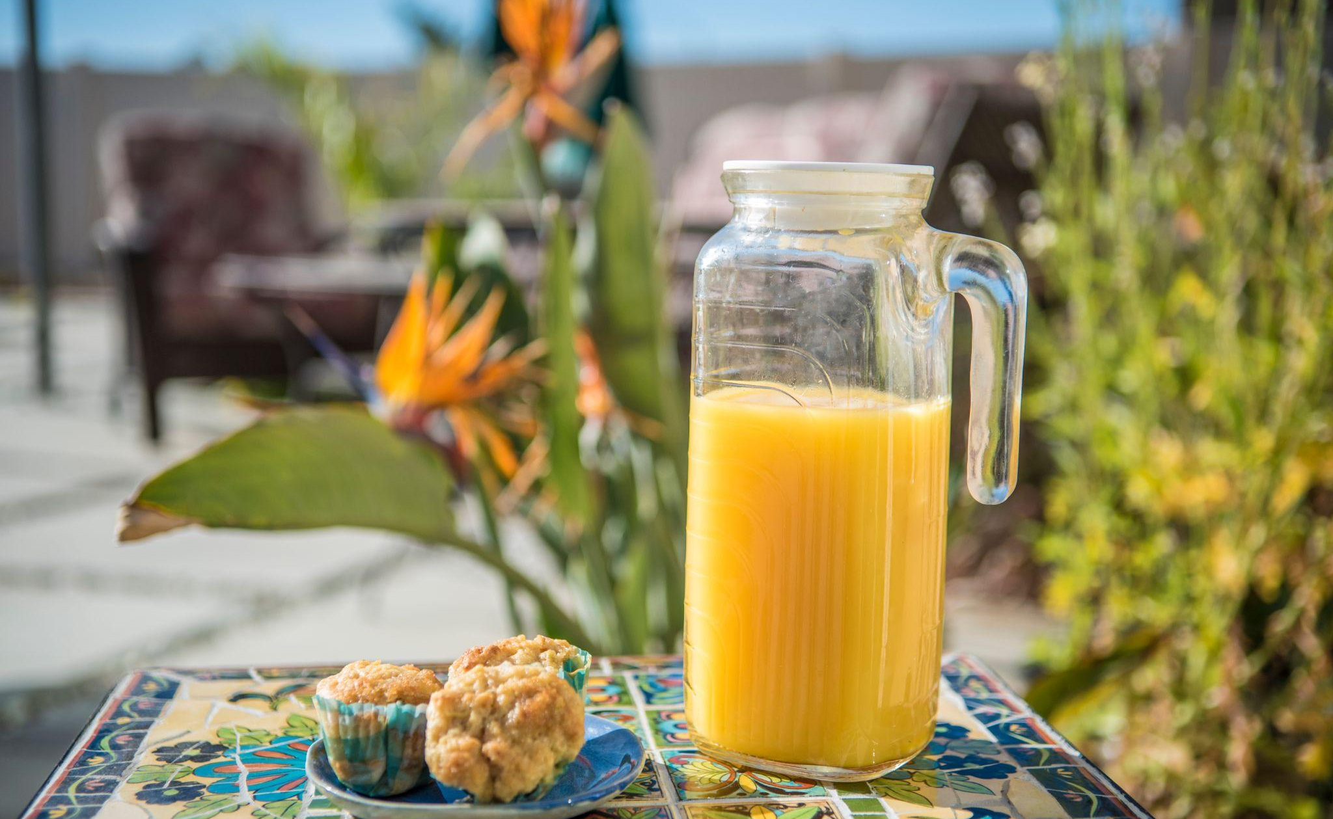

Photography Examples
You can find these on stock photography sites and license as royalty free. The idea is: communicate images of home, comfort, joy… do not use medical imagery except for rehab and use Those types of images sparingly. Showing the outcome of rehab is stronger.

Slide 8
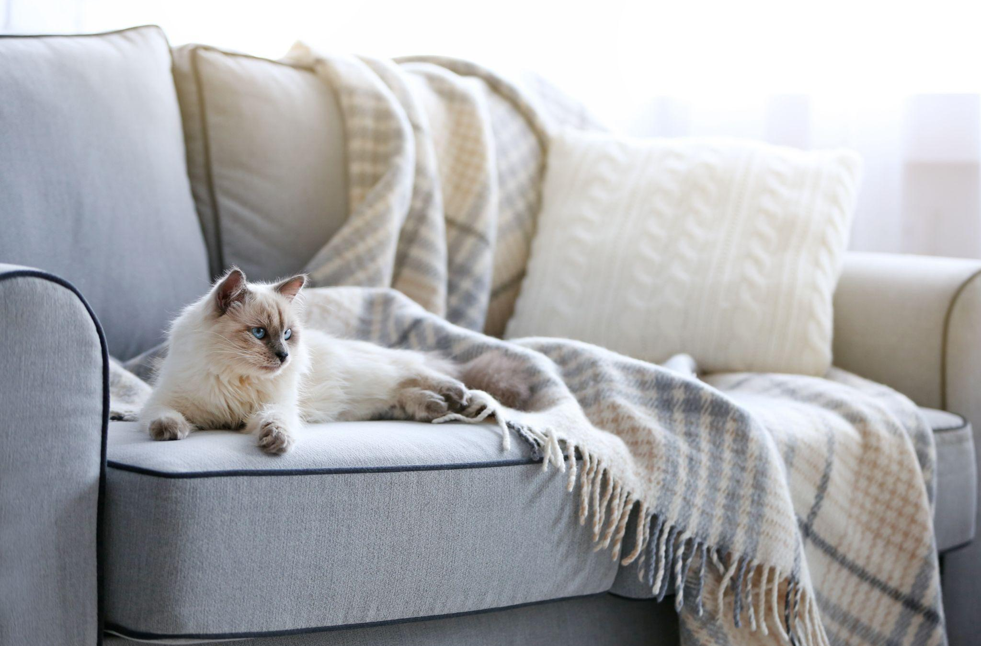

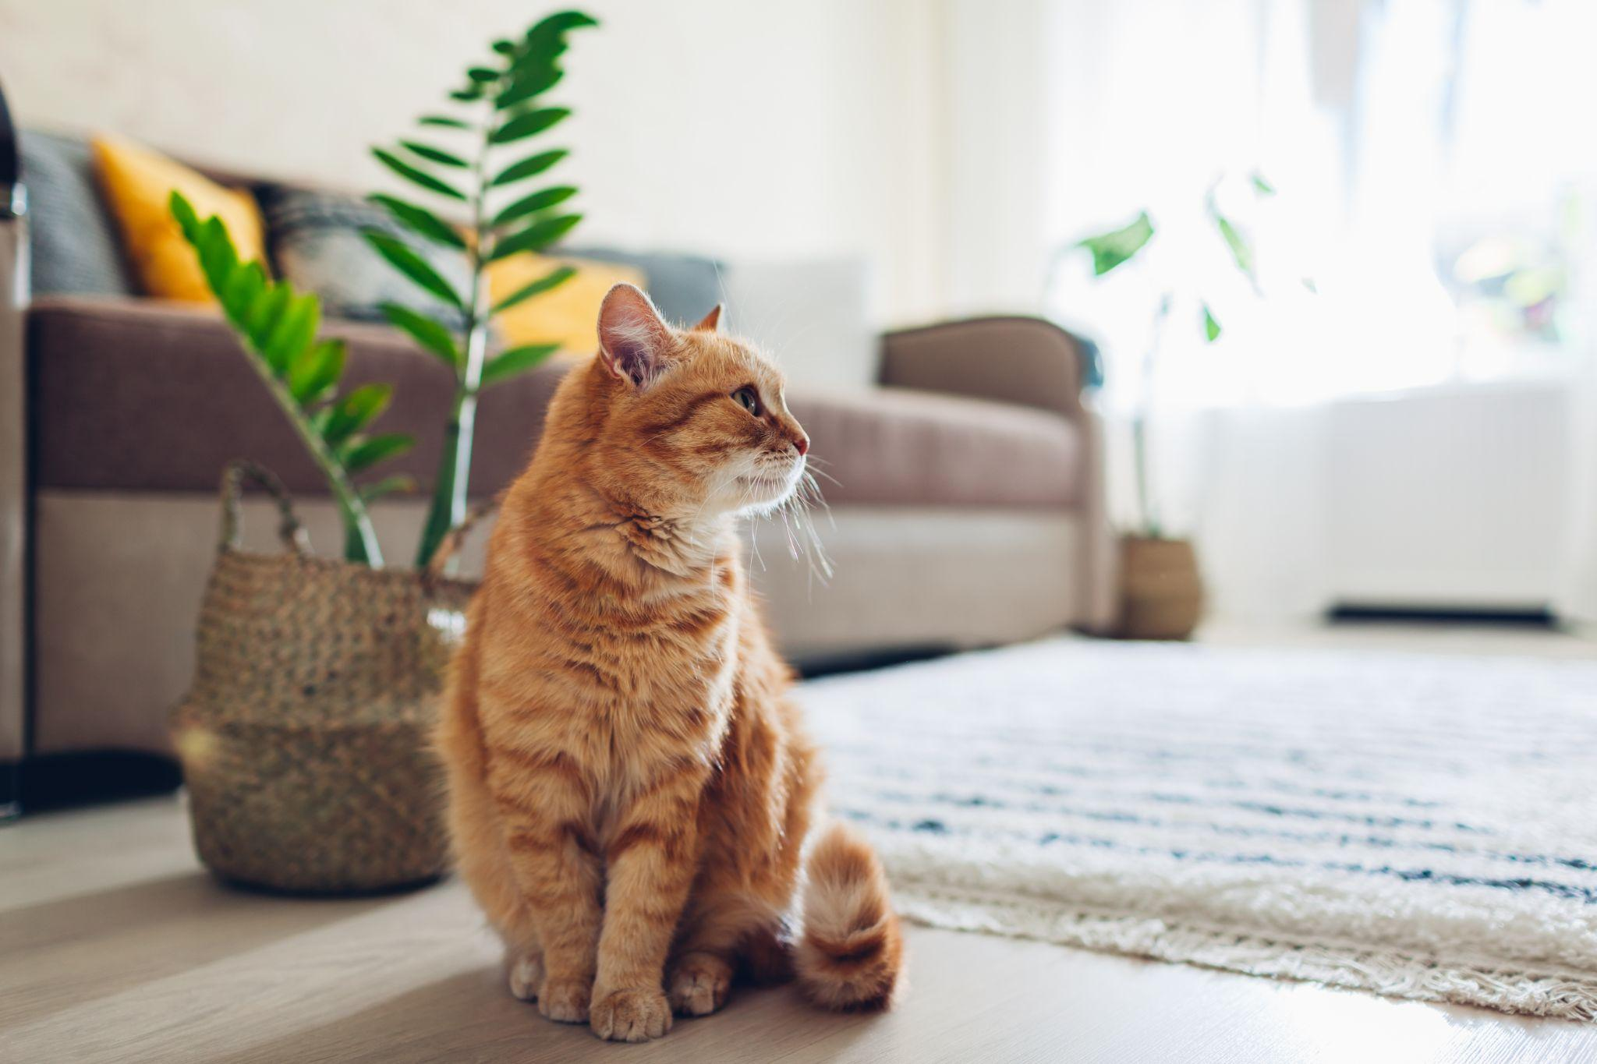

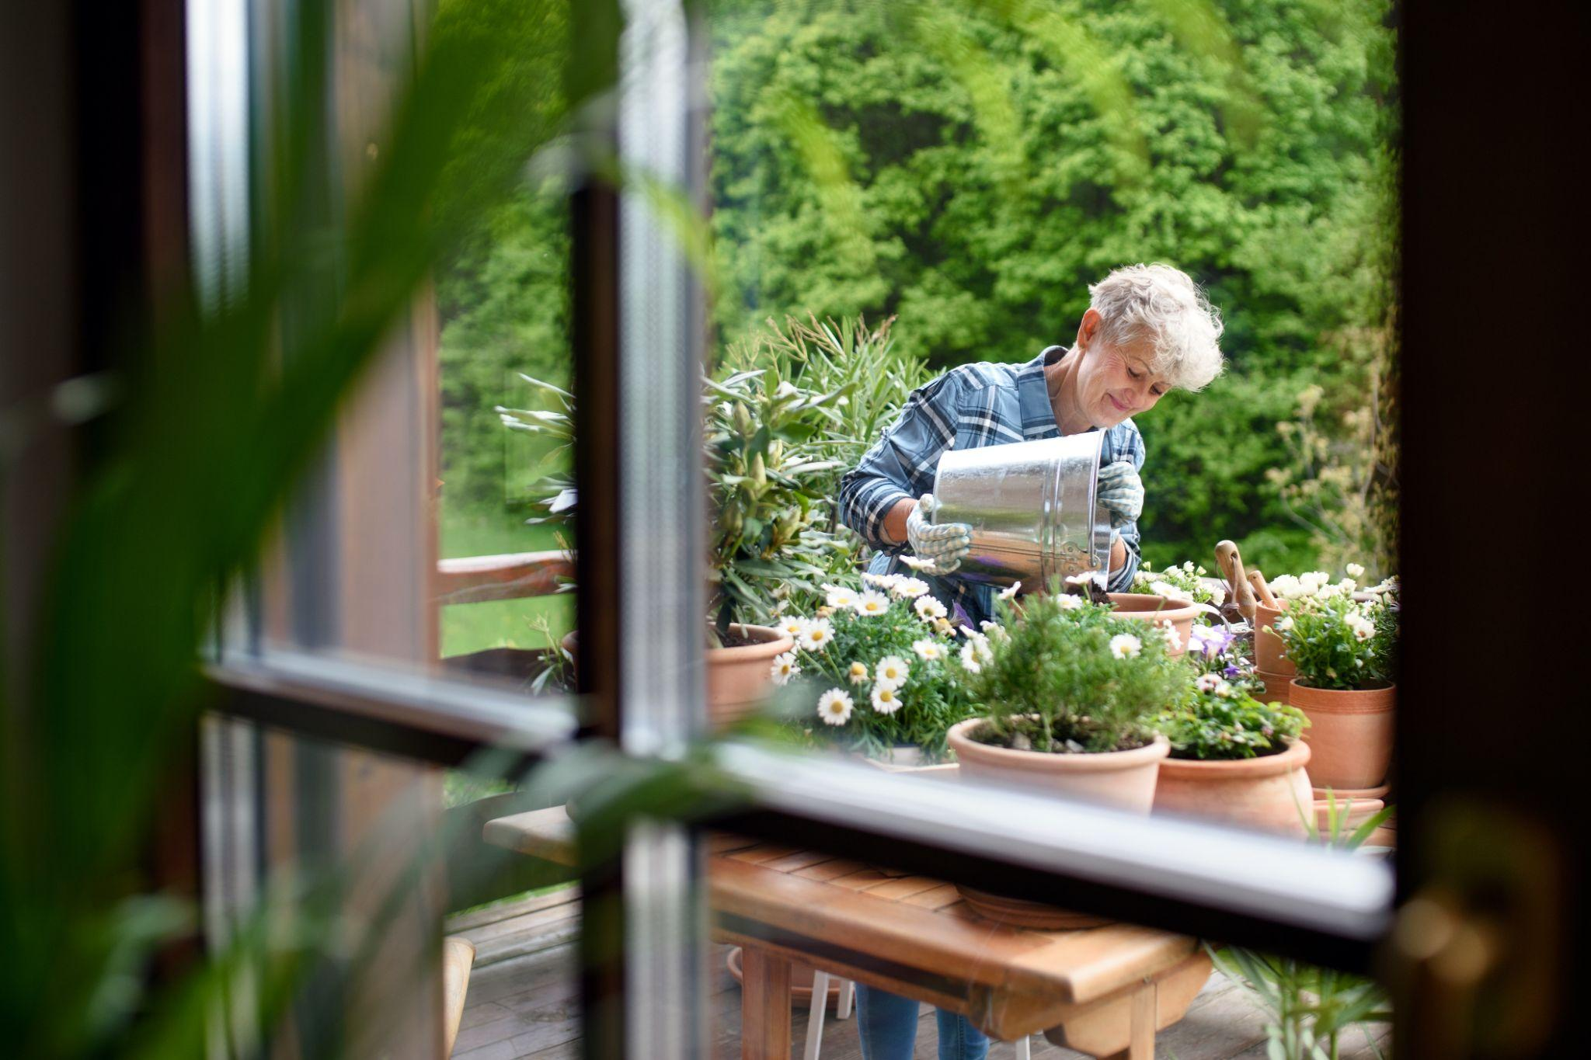
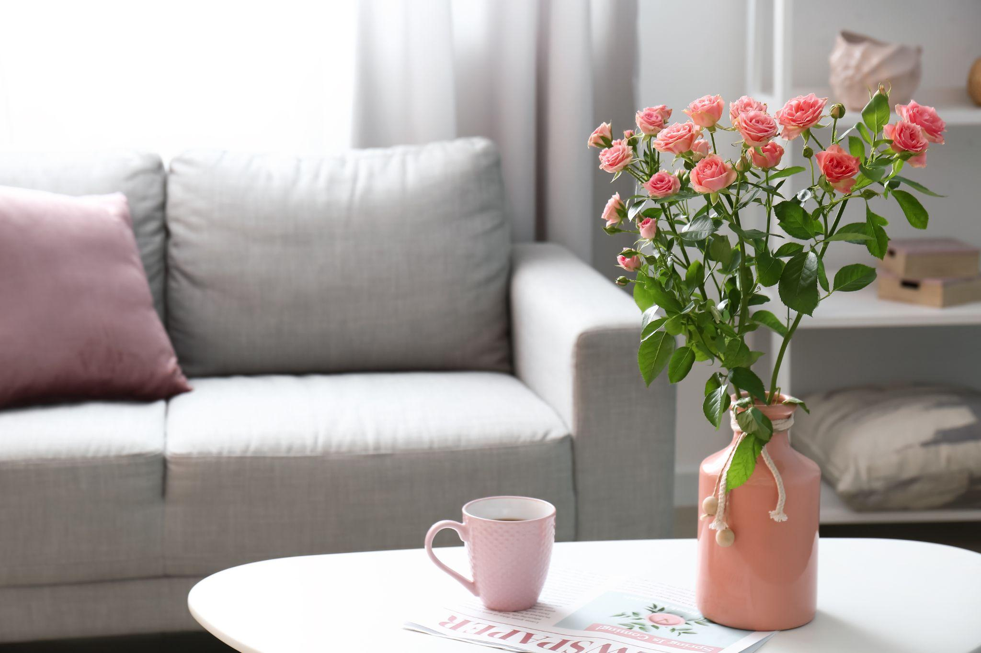
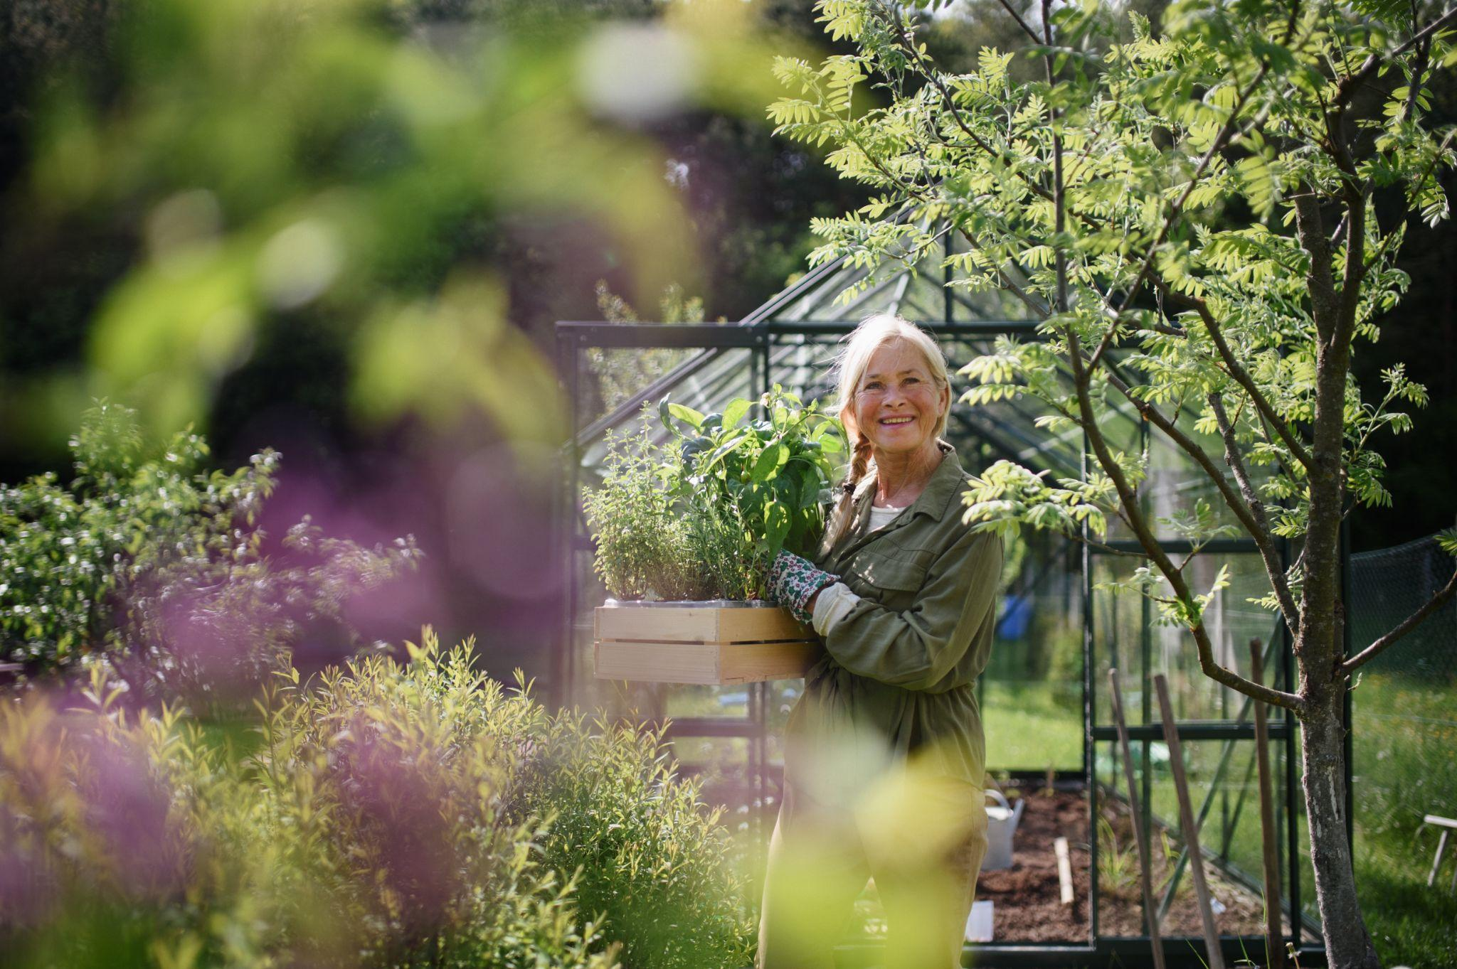
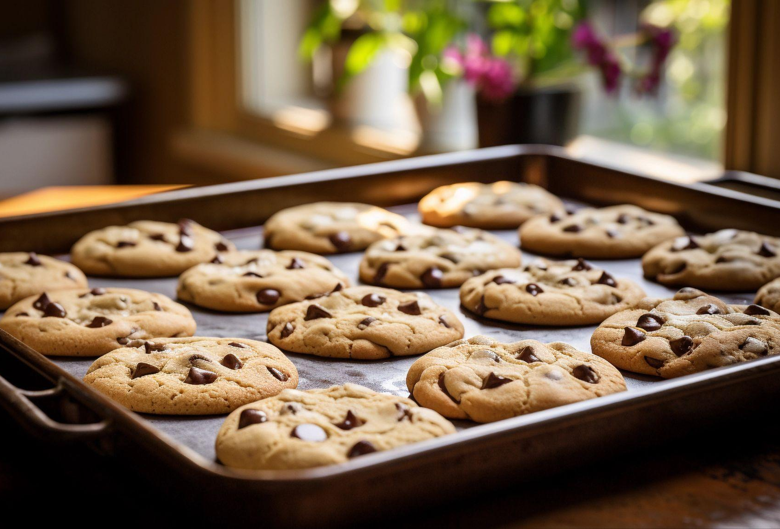
Photography Examples
You can find these on stock photography sites and license as royalty free. The idea is: communicate images of home, comfort, joy… do not use medical imagery except for rehab and use Those types of images sparingly. Showing the outcome of rehab is stronger.

Slide 9
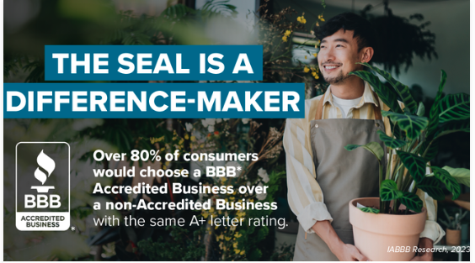
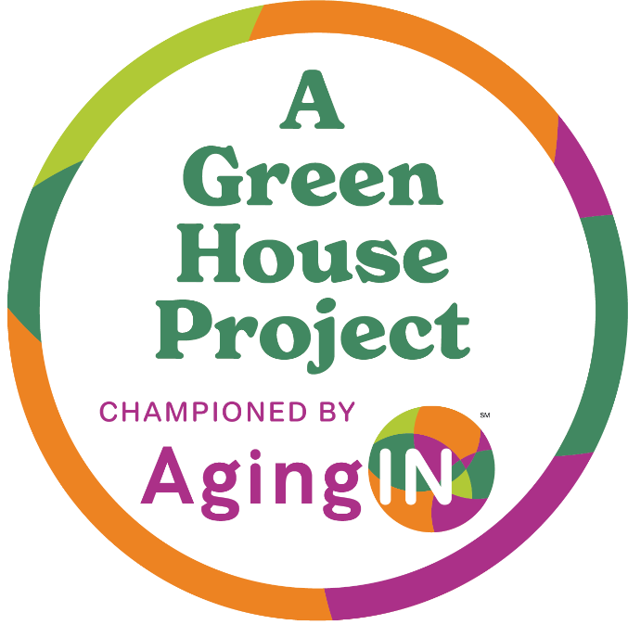
Website Assets
AgingIN Bug: For your home page
AgingIN Ethos Landing page: for Green House homes to use
Written content: for use in flyers, blogs or advertisements. Advertorials are great!
Much like consumers know to look for the Better Business Bureau seal, the Green House Project seal sets your community apart for having made the investment in a platinum standard.

Slide 10
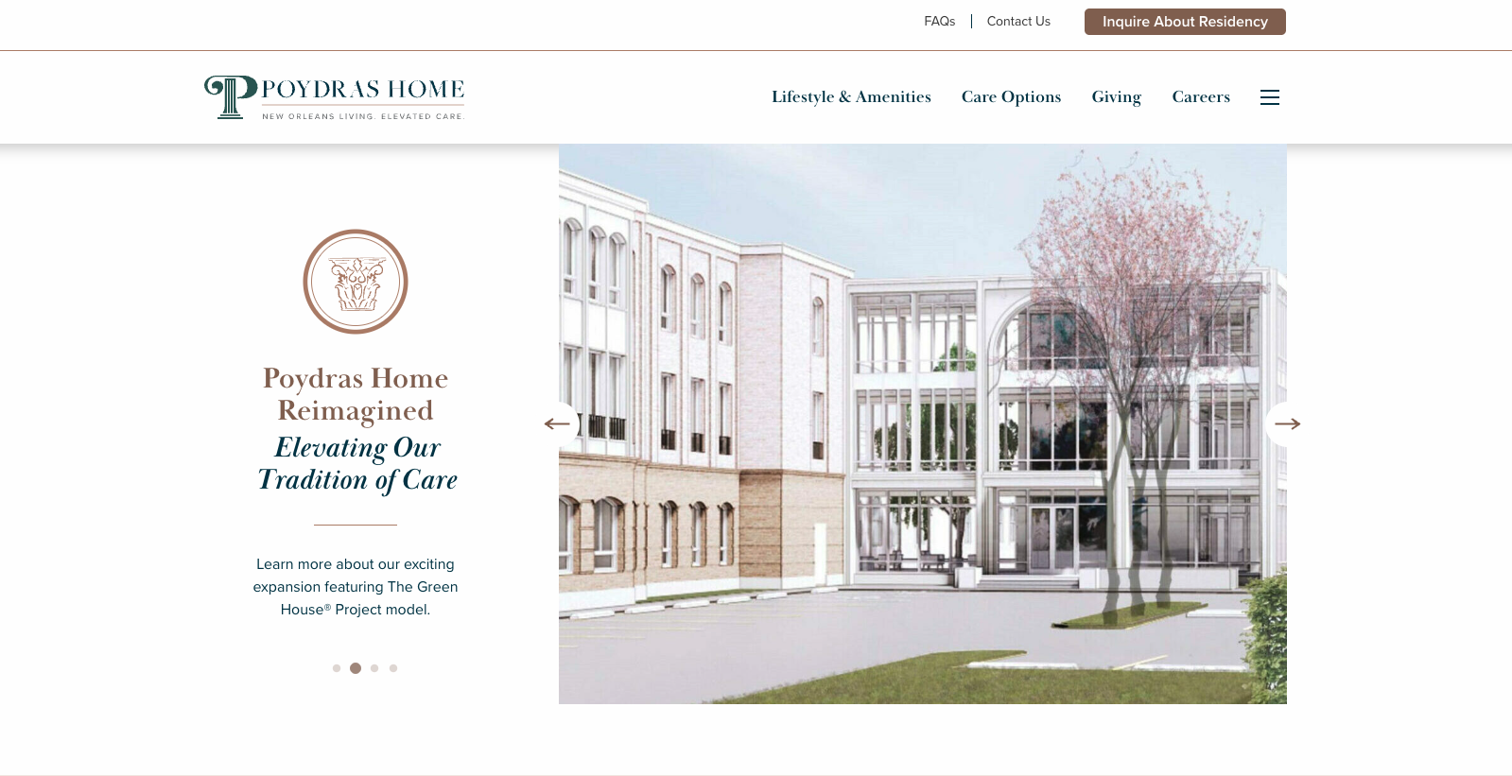

Slide 11
AgingIN Ethos Web Landing Page
This landing page is what Green House Homes can add to their website and then link to this when advertising, blog writing or performing public relations.
Headline: Why Small Homes Matter: Evidence, Impact, and What We Can Do Next
When we think small, we often think simple. But the Green House model is far from simplistic, it’s deeply intentional and built on practices of emotional intelligence and collaboration by our care team. In our setting, “small” means fewer residents, only 12, living in households where humanity is at the core. Plants, hobbies, animals, easy access to the outdoors, intergenerational relationships and more. All designed to provide a satisfying life, no matter the physical limitation.
Green House homes are intentionally designed, built and operated by flipping the “medical care model” upside down. A care professional is at the helm with the medical professionals in support. This means that residents within Green House homes are in control of their preferences and lifestyle. They have features you don’t see in medically driven skilled nursing communities.
Studies of this human-based approach have shown striking results: during COVID-19, Green House homes experienced over 60% fewer infections and 70% fewer deaths per 1,000 residents compared to traditional nursing homes. The model’s advantages include private rooms, consistency of staffing and limited foot traffic that together translate into safety, dignity, and resilience.
Measuring What Matters: The Green House Annual MERIT Self Assessment. As a Green House at AgingIN home, our commitment to person-directed living isn’t just philosophical, it’s measured annually when AgingIN administers the Green House Annual MERIT Self Assessment across every trademarked Green House home. This comprehensive assessment is completed by every member of our skilled nursing team and is designed to give a clear, honest snapshot of how we’re doing. The assessment measures key indicators such as:
Employee satisfaction and engagement
Care processes and team culture
Alignment with person-directed living principles
How well daily practices reflect meaningful life, real home and empowered staff See next page for continuation…

Slide 12
AgingIN Ethos Web Landing Page, continued
The results help us step back, reflect, and identify both strengths and opportunities. Just as importantly, the survey keeps us focused on what matters most: supporting care professionals and delivering the best possible care experience for the people who live here.
Why This Matters to Residents & Care Professionals. Residents deserve care rooted in both compassion and rigor. Care partners deserve tools that are tested, not just hopeful. As Green House operators, we’re proud to stand at the intersection of heart and science. Our residents deserve no less.
Role of AgingIN Green House Homes & Research
But it doesn’t stop there. AgingIN’s mission is to push beyond those numbers, to explore how environment, culture, staff empowerment, and autonomy contribute to outcomes. Through its research partnerships and culture-change tools, AgingIN helps communities like ours calibrate and deepen impact.
See next page for continuation of copy…

Slide 13
AgingIN Ethos Web Landing Page, continued
Who is AgingIN?
AgingIN helps aging services organizations create communities that they would be proud to choose for themselves and their families. Their independent research supports this claim.
Through world-class consulting, technical assistance, and education, AgingIN empowers elder care providers to implement lasting change and cultural transformation that is meaningful and measurable. Simply put, it works.
Formerly known as the Center for Innovation, AgingIN is a global nonprofit born from the merging of two of the most influential movements in long-term care: Pioneer Network and The Green House ® project For more than 30 years, they have been leading the charge to dismantle outdated models, elevate care professionals, and create environments where older adults can live fully, with dignity.
AgingIN is the only global nonprofit organization that connects care partners and elders with academic research and real-world practice. We do this by bringing together providers, researchers, policy makers, regulators, and advocates from every corner of the aging services ecosystem.
JoinIN!

Slide 14
Green House Home Articles or Blog Content
Article 1. “From House to Home: Why Person-Directed Living Changes Everything”
In many care settings, the difference between a “place you live” and a “home you belong to” comes down to culture, not bricks and mortar. At [Your Community Name], we’ve embraced and invested in the Green House philosophy to make that difference real.
Green House homes don’t just reduce the scale, they shift who holds power. When older adults living in skilled nursing settings direct their routines and care partners share in decision-making, amazing things happen: deeper relationships, fewer institutional routines, and real joy in everyday moments. That’s how we manage our community.
Evidence & Connection to AgingIN
AgingIN exists to help providers like [Your community name here] to translate research into daily practice. Their work in “culture change” draws on decades of models such as Green House and Pioneer Network, helping communities like ours move from theory to living transformation.
At our community, we left behind “how we’ve always done it,” and started changing our culture to empower care professionals to support residents in directing their lives. We’re proud to say that this home is a learning lab, and AgingIN is our partner in that journey.

Slide 15
Green House Home Articles or Blog Content
“Bridging Research & Reality in Elder Care” In care communities, we often hear that “best practices” feel distant or abstract. At [Your Community Name], we believe research should live, not just in academic journals, but in dining rooms, care team huddles, and resident conversations.
As a Green House at AgingIN home, AgingIN’s research partnerships work to make that possible. They connect academic teams with communities to test new approaches in care protocols, workforce culture, and health outcomes. Practices and approaches are grounded in evidence, instead of guesswork. Measuring What Matters: The Green House Annual MERIT Self Assessment. As a Green House at AgingIN home, our commitment to person-directed living isn’t just philosophical, it’s measured annually when AgingIN administers the Green House Annual MERIT Self Assessment across every trademarked Green House home. This comprehensive assessment is completed by every member of our skilled nursing team and is designed to give a clear, honest snapshot of how we’re doing. The assessment measures key indicators such as:
Employee satisfaction and engagement
Care processes and team culture
Alignment with person-directed living principles
How well daily practices reflect meaningful life, real home and empowered staff
The results help us step back, reflect, and identify both strengths and opportunities. Just as importantly, the assessment keeps us focused on what matters most: supporting care professionals and delivering the best possible care experience for the people who live here.
Why This Matters to Residents & Care Professionals. Residents deserve care rooted in both compassion and rigor. Care partners deserve tools that are tested, not just hopeful. As Green House operators, we’re proud to stand at the intersection of heart and science. Our residents deserve no less.

Slide 16
Green House Home Articles or Blog Content
‘Learning What Stays: How Ongoing Education Anchors Culture Change’
Culture change isn’t a workshop. It’s what our team does on Mondays. At [Your Community Name], we’ve learned that to make person-directed living stick, we need continuous learning, not occasional events and that’s exactly what we do.
As an AgingIN Green House home, that’s where our partner AgingIN’s education model shines: immersive, actionable, and support-oriented. They don’t throw slides at us and leave. They coach our leaders, support our care partners, and help us to embed best practices that resist fading over time.
Add a Community Example [Below is an example. But create your own.]
We recently engaged in an AgingIN-led memory care session using the Best Life framework. Rather than treating this as a “to-do,” our care team applied key ideas immediately – small conversation prompts, environmental cues, and micro-reflections at shift change. The shift? More connection with residents, and more curiosity.
At [community name] we don’t see this as a one-off “in service day,” we challenge ourselves regularly to reframe these sessions as conversations, not just classes. We consistently return to the principles of person-directed living. Real change only comes with ongoing practice, and that’s a path that we follow with AgingIN as our partner, walking with us to continuously improve our care.

Slide 17


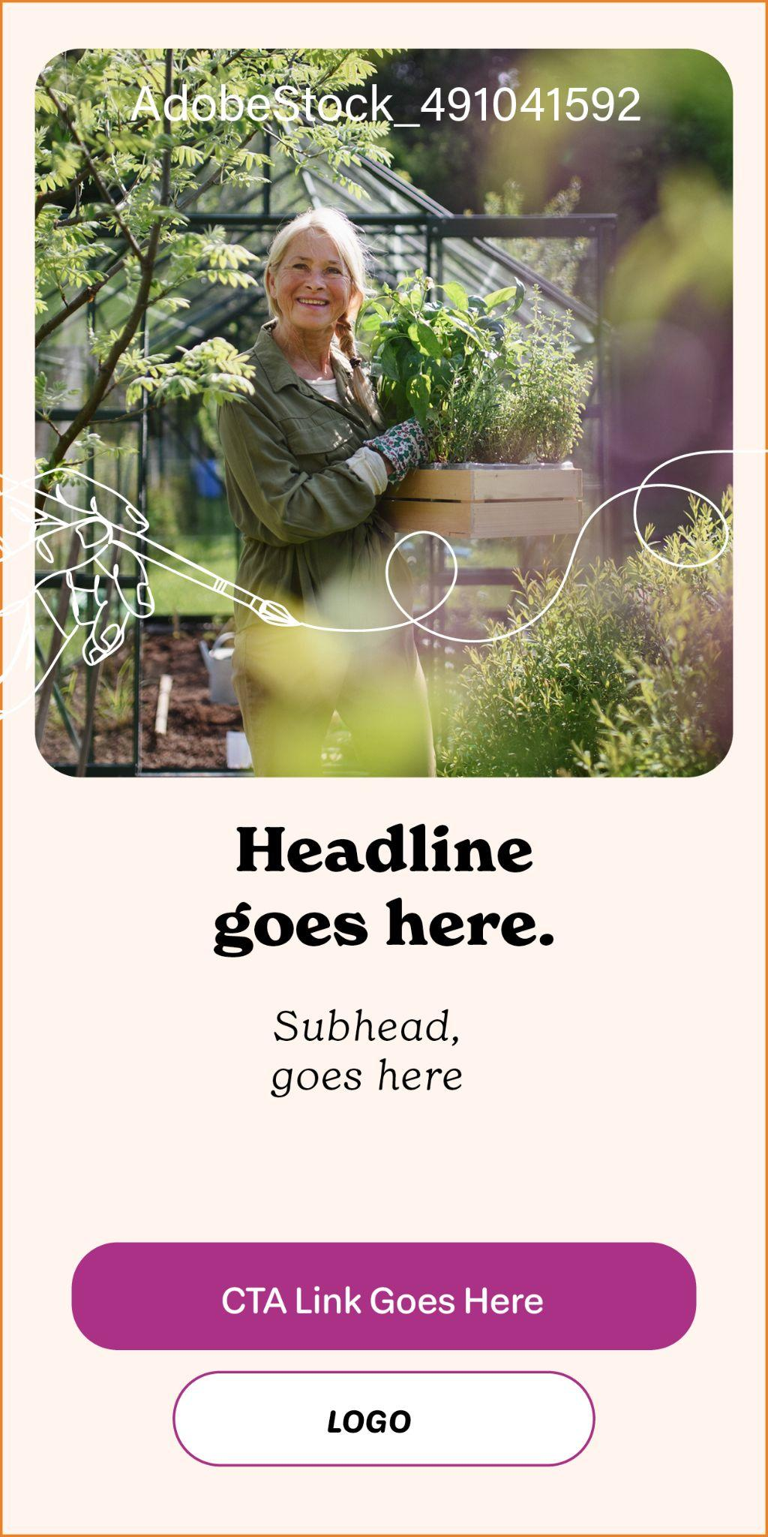

Half and Quarter page / Digital Templates
You will receive native digital files

Slide 19
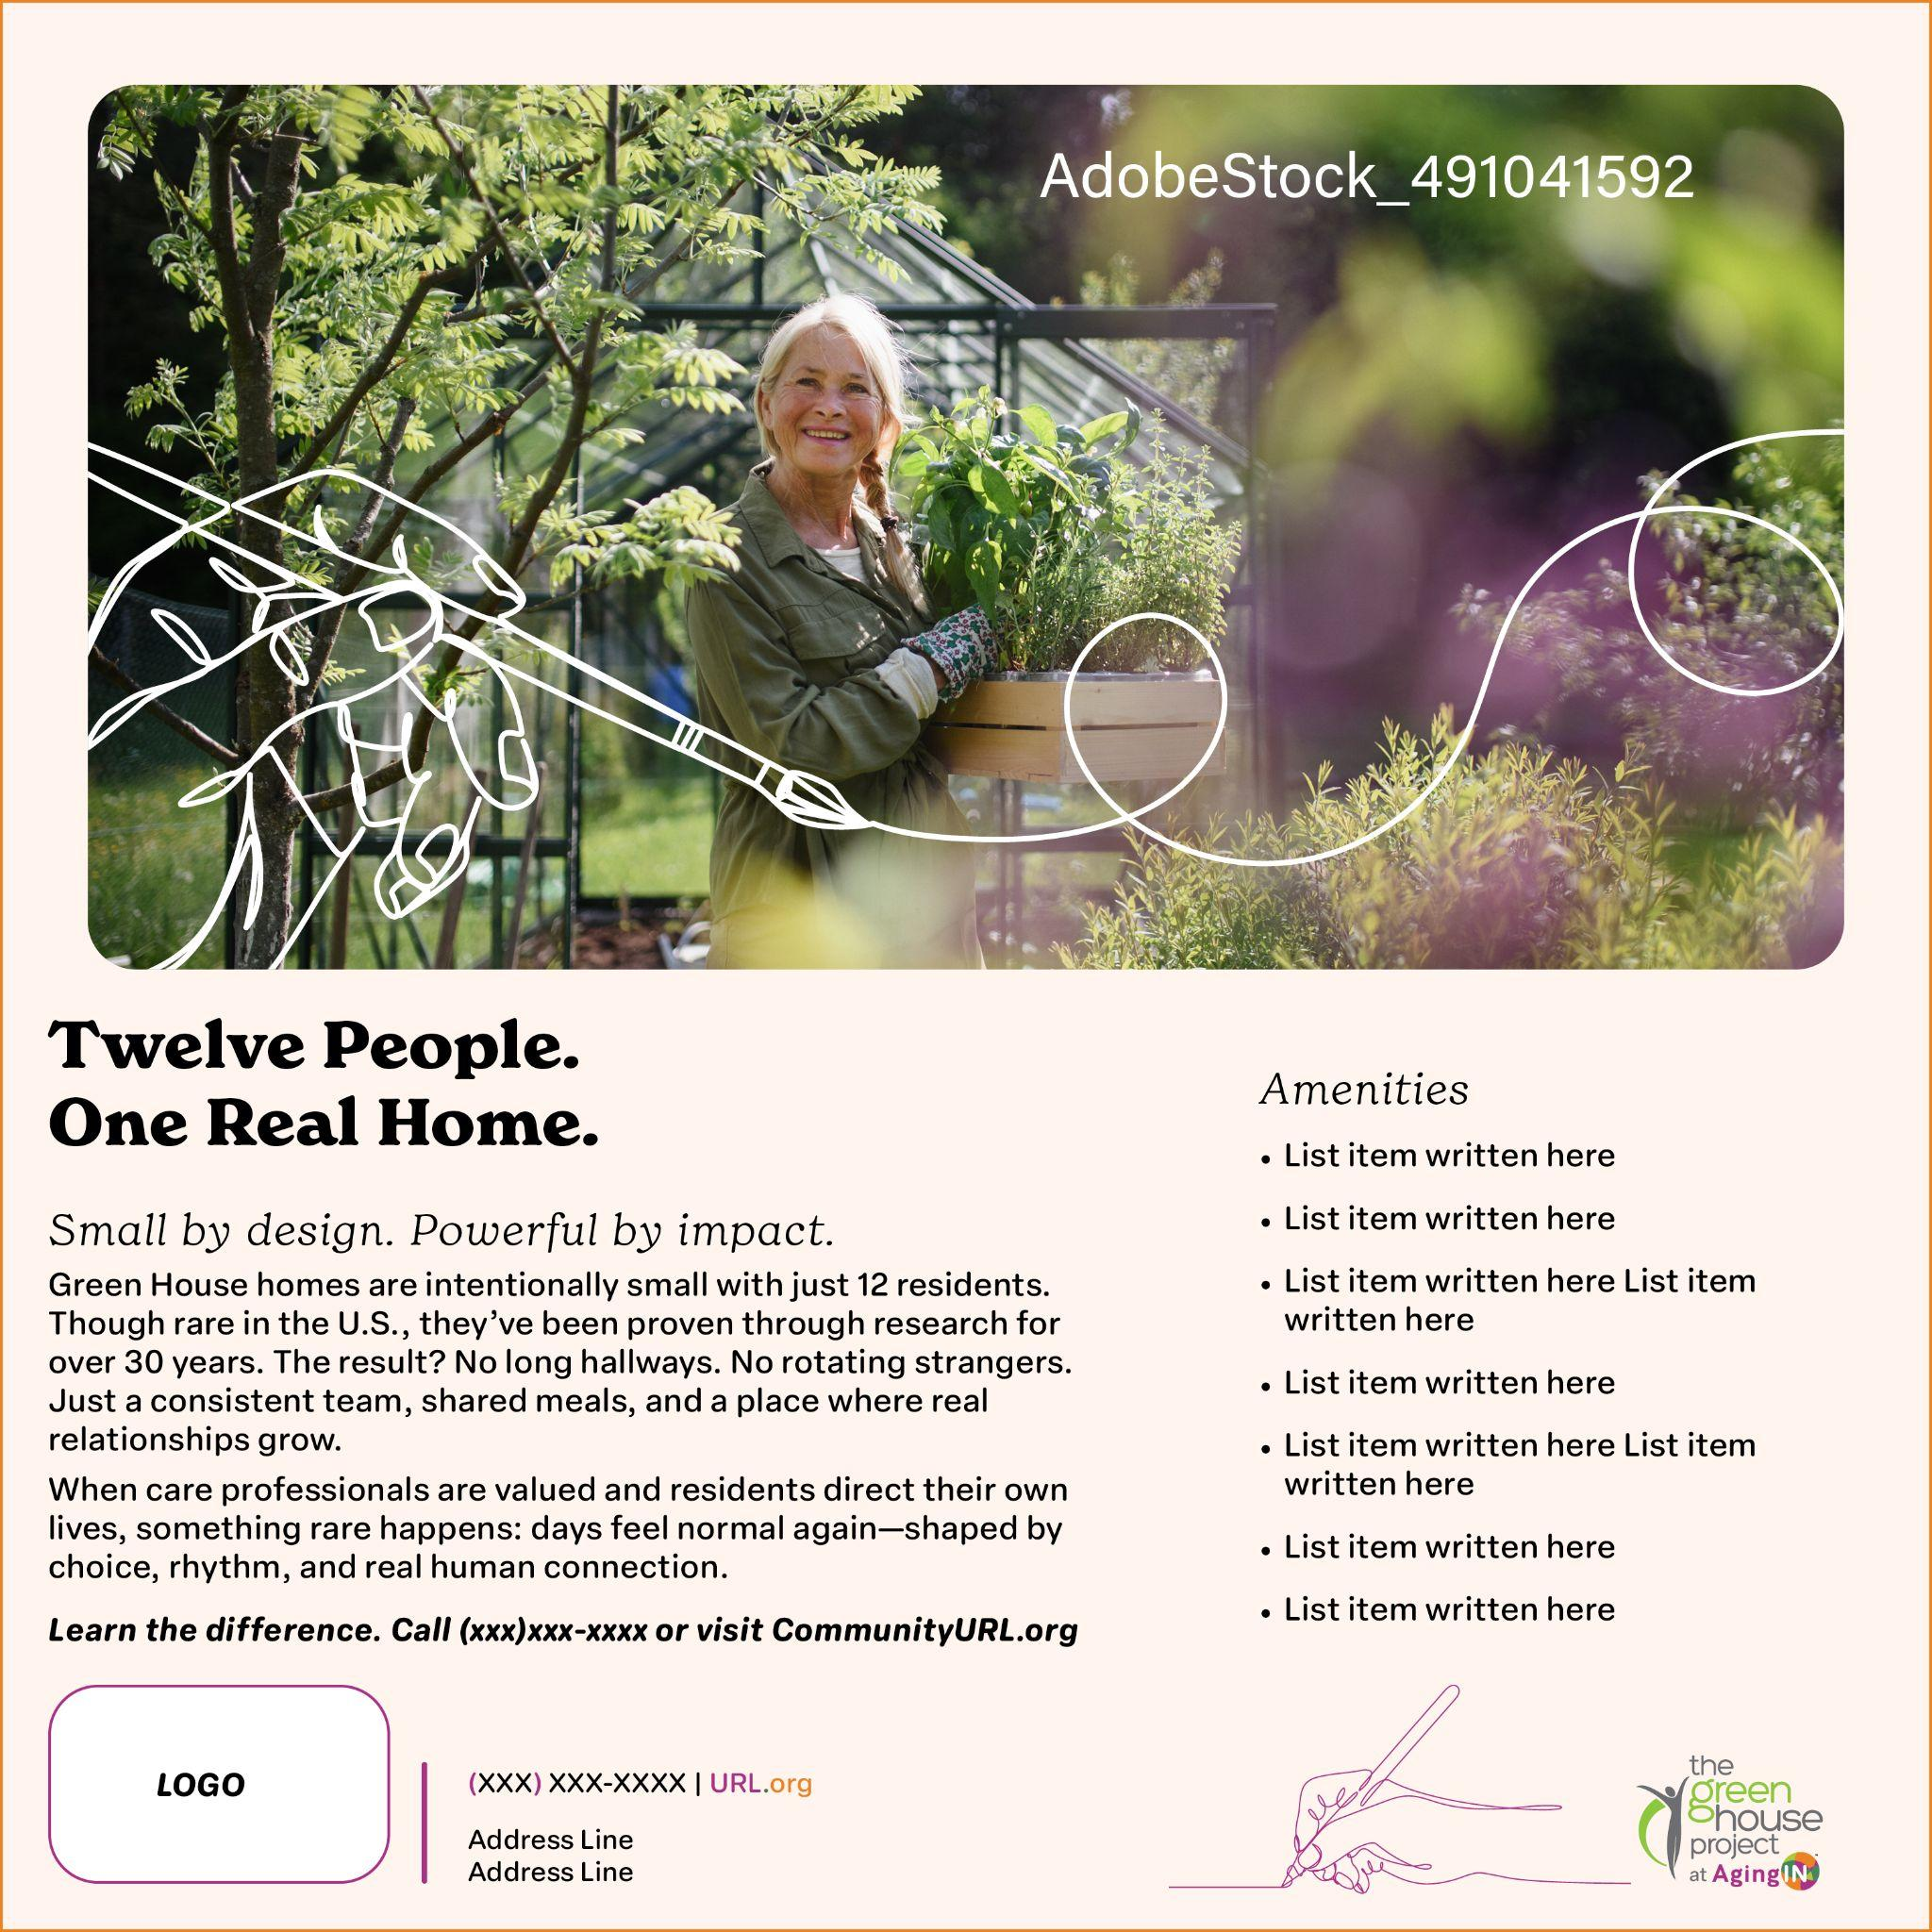
Half page AgingIN Template
Headline: Twelve People. One Real Home.
Subhead: Small by design. Powerful by impact.
Green House homes are intentionally small with just 12 residents. Though rare in the U.S., they’ve been proven through research for over 30 years. The result? No long hallways. No rotating strangers. Just a consistent team, shared meals, and a place where real relationships grow.
When care professionals are valued and residents direct their own lives, something rare happens: days feel normal again—shaped by choice, rhythm, and real human connection.
Learn the difference. Call (xxx)xxx-xxxx or visit CommunityURL.org

Slide 20
Half page AgingIN Template
Headline: At [Community] skilled nursing has been reimagined around real life.
Subhead: We believe home comes first and care supports it.
Body Copy: In Green House homes, daily life looks and feels like home because that’s the goal. Medical care is essential—but it’s the foundation beneath living, not the driver of it. Residents direct their days, their rhythms, and their routines.
Learn the difference. Call (xxx) xxx-xxxx or visit CommunityURL.org

Slide 21
AgingIN Advertising Copy
Headline: Not All “Small Homes” Are Green House Homes. The Difference Matters.
Green House homes partnered with AgingIN meet rigorous standards for person-directed living, workforce empowerment, and household design. This isn’t marketing language—it’s a proven model with decades of research behind it.
Learn the difference. Call (xxx)xxx-xxxx or visit CommunityURL.org

Slide 22
Quarter page AgingIN Template
Headline: A Proven Model. A Higher Standard of Living.
Subhead: Backed by research. Built on respect.
The Green House model is one of the most studied approaches in skilled nursing. The evidence is clear: stronger relationships, higher staff retention, and better quality of life for residents.
Learn the difference. Call (xxx)xxx-xxxx or visit CommunityURL.org

Slide 23
Advertisement Copy for Your Own Format
Headline: Small by design. Powerful by impact.
At [Community Name], a Shahbaz is the heart of our small household model. Rather than the “medical model” where a nurse runs the floor, this is a trusted care professional who runs the home and honors each person’s preferences, rhythms, and dignity while being supported by the nurse. It’s also called person-directed living. It means life here looks and feels like real home, where decisions are shaped around the individual, not the institution.
Because care should be as human as the people who give it, and as personal as the people who live it.
About [Community Name] [Community Name] is committed to redefining aging and care through respect, compassion, and innovation. Then add your own copy description after.
PLAN AHEAD WITH CONFIDENCE: JOIN US FOR A FREE COMMUNITY EVENT OR TOUR
Planning for Your Own Future Care 101 We never know when life may bring a need for skilled rehabilitation or care. By planning ahead, you can be ready for the “what ifs.” Join us to learn proactive steps and discover options for future peace of mind.
[Date] • [Time] • [Location]

Slide 24
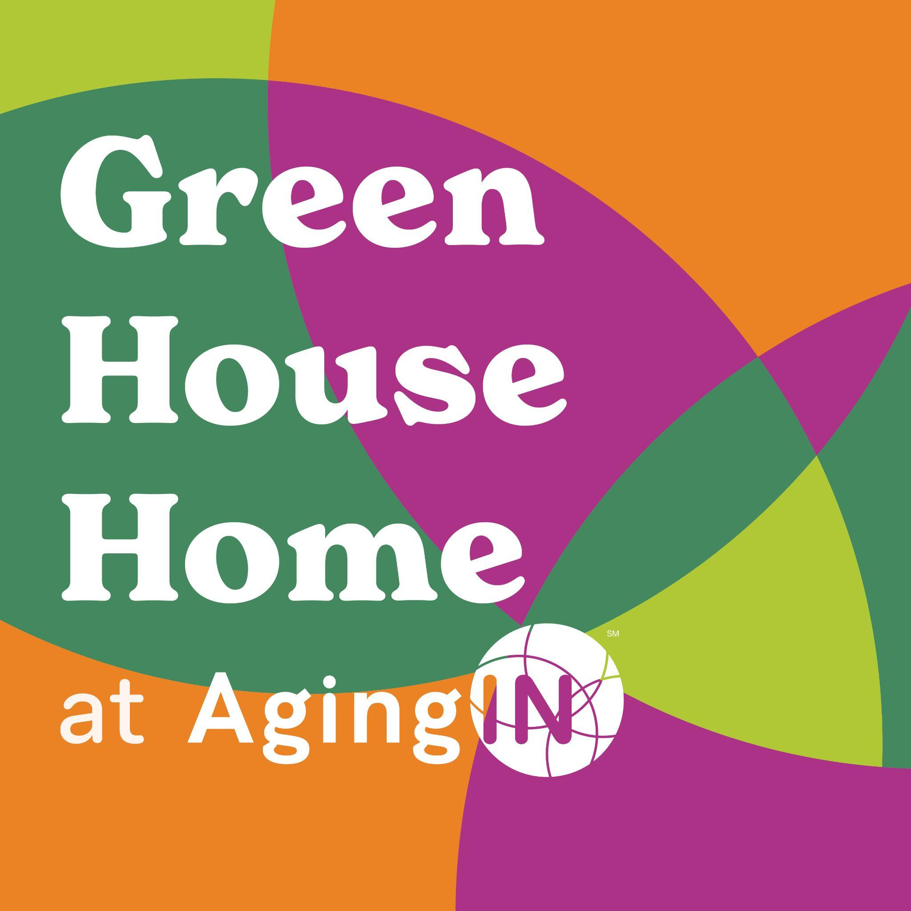
Window Cling Art
Description: Approximately 5”x5” or 6”x6”
Window Clings Are Affordable and Effective
Average cost, $10 - $20 at Vista Print or most quick printers.
Purpose: To differentiate your community as having invested in the premier class, person-directed living setting.

Slide 25
Thank you!
Any Questions?

